Slide 1


Stock Analysis Top Five High-Tech Companies
Project 4, Group 5
Dany Roman
Ishan Chakrabarty
Jucary Estrada
Morteza Akbari

Slide 2





Objectives
Project Objective
Create a neural network model that will predict stock prices of 5 top tech companies
Dataset
Used a kaggle dataset with stock prices for:
Advanced Micro Devices, Inc. (NASDAQ: AMD)
Alphabet Inc Class A (NASDAQ: GOOGL)
Helmerich & Payne, Inc. (NYSE: HP)
Intel Corporation (NASDAQ: INTC)
Tesla Inc. (NASDAQ: TSLA)
Source
Kaggle: High-tech stock prices
Science Direct: Stock Closing Price Prediction using Machine Learning Techniques

Slide 3
Approach
High-Low; Close-Open;
7-day avg, 14-day avg, 21-day avg;
7-day Std.Dev.
Raw Stock Data
Pandas
relu
Prepped Stock Data
relu
Neural Network
Stock price predictions using recent
Yahoo Finance stock data
linear
Prediction Data
Visualize using Tableau
Actual vs Predicted Price
Predicted price

Slide 4
Discussion
Created a neural network regression model that attempts to predict the stock prices of 5 top tier tech companies
Requires further optimization to determine the best settings (# nodes, # layers, activation, etc)
Challenges
Model recognizes the overall trends but overshoots its predictions
Model struggles with high priced stock more than low priced stock (more variability)
Time...

Slide 5
Data Preparation
Imported datasets of top tech companies into pandas as dataframes
Dropped unnecessary columns (Dividends and Stock Splits)
Imported Yahoo finance library into jupyter notebook and obtained the necessary information to match the training data columns.
Created a function to determine moving average of stock price based on 7, 14, and 21 days and ranges between opening and closing price and high and low prices.

Slide 6
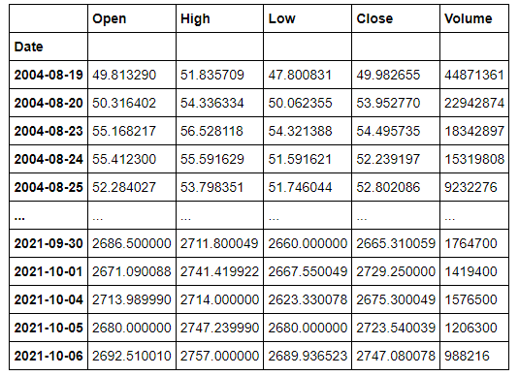

Slide 7
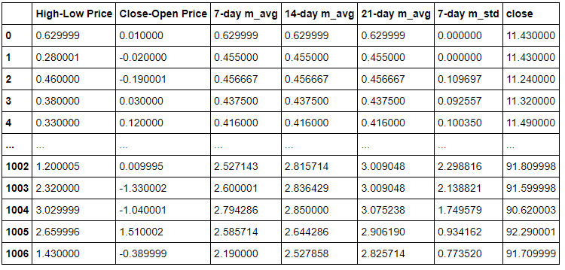

Slide 8
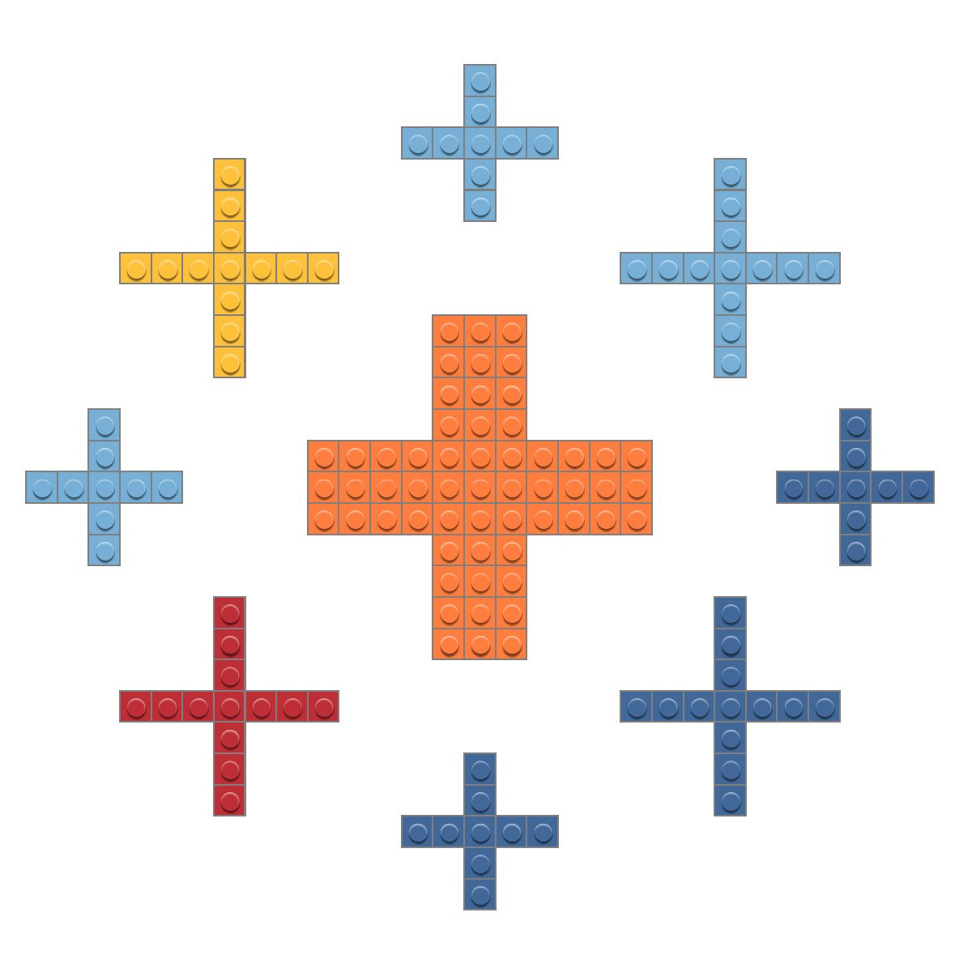
Tableau was used to show visualization of our data results.
Predicted Close vs. Actual Close was analyzed.
Visualizations of the Tech Stocks are published.
Tech Stocks | Tableau Public

Slide 9
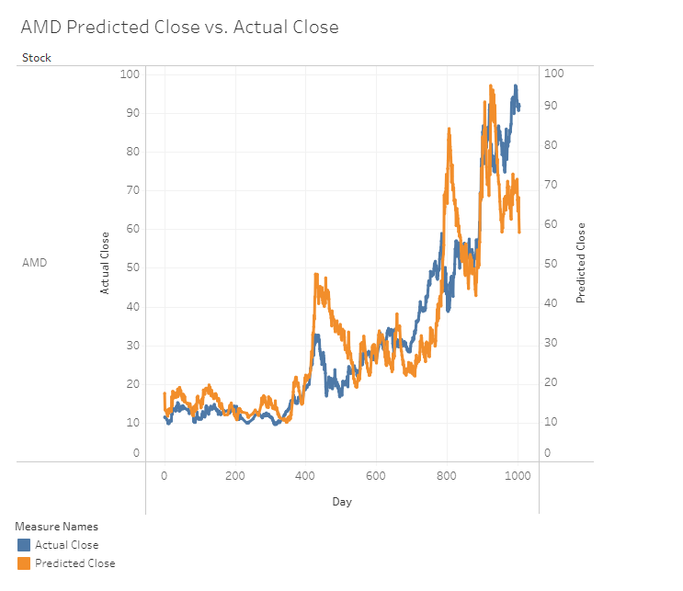
AMD example of the graphs created with Tableau.

Slide 10
Questions?

Slide 11
